Slide 1
Using Computer Aided Diagnosis to Aid Cancer Screening and Diagnosis
Brian Craft
Cat Martin
Yoseph Mendelsohn
Missy Sun
Alexander Todd

Slide 2
Overview
Problem: Image based malignant classification has inter-doctor variance and isn’t accurate enough to define cancerous nodules.
Proposed Solution: Used probabilistic machine learning to quantify the likelihood a nodule is malignant.

Slide 3
Overview of Dataset
Observations: ~ 40,000
Distinct Nodules: ~ 2,700
Avg. Slices per Nodule: ~ 15
Data Size: ~ 50 MB
Features:
Attributes based on size, shape, and features of nodules: e.g. area, perimeter, lobulation, spiculation, calcification, etc
Attributes based on intensity: e.g. max intensity, min intensity, mean intensity, etc
Attributes based on texture: Haralick features, Gabor features, Markov Random Fields

Slide 4
Overview of the Studies
Number of Studies: 866
Maximum Group Size: 316
Maximum Group Percentage: 0.8%
Minimum Group Size: 1
Minimum Group Percentage: 0.00253%
Number of Radiologists: 4
Notes:
These are general figures to drive further analysis of dataset. It will be easier to look at the dataset in terms of the studies or distribution by the number of the radiologists.

Slide 5
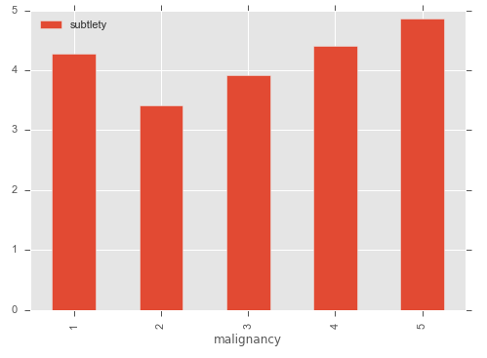
Subtlety Attribute
The chart to the right shows the average subtlety rating by malignancy rating.
As the nodule has more subtlety to it the malignancy increases.

Slide 6
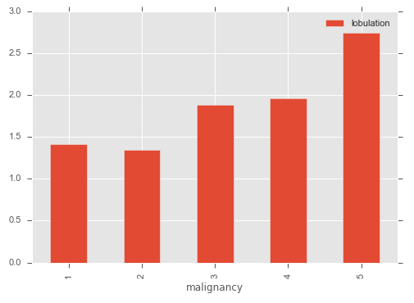
Lobulation Attribute
The chart to the right shows the average lobulation rating by malignancy rating.
More lobulation means a higher malignancy rating.

Slide 7
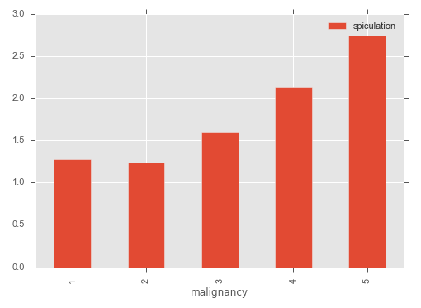
Spiculation Attribute
The chart to the right shows the average spiculation rating by malignancy rating.
As the nodule looks more suspicious or complex, the malignancy rating increases.

Slide 8
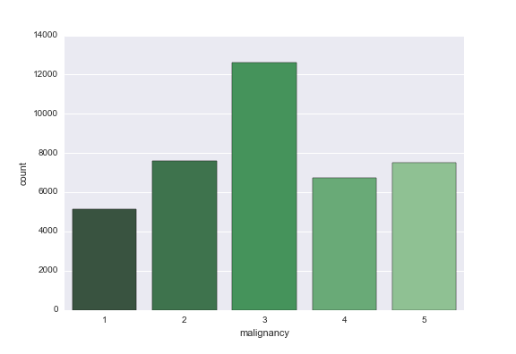
Target Attribute: Malignancy Rating
1-5 rating based on how “malignant” the nodule looks. The right shows a histogram of the malignancy ratings. There is a top heavy skew.
However, each slice really has a probability function associate.
{ Slice_id : [r1, r2, r3, r4] }
Notes:
Python dictionary at the moment

Slide 9
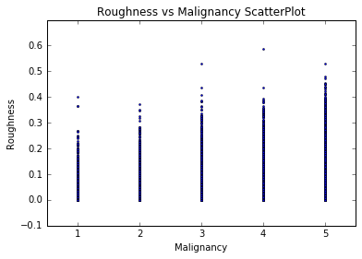
Roughness
￼￼
￼Roughness is a measure of how closely a tumor’s edge follows those of a circle.
There seems to be a relationship between Roughness and Malignancy.
We see that higher roughness is often associated with higher perceived malignancy, but many malignant tumors can still have 0.0 roughness.

Slide 10
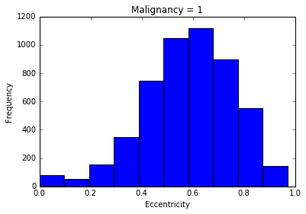
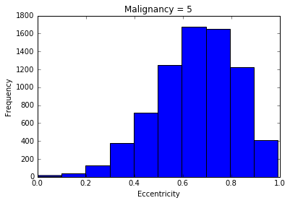
Eccentricity
Lower eccentricity corresponds to a less elliptical shape in the tumor.
By charting the histograms of tumors rated Malignancy 1 and those rated Malignancy 5, we see a considerable difference in the frequency of low eccentricity.
Malignancy 5 has higher instances of Eccentricity >0.6, and virtually none with Eccentricity = 0.

Slide 11
Markov Features
Markov features are derived from the concept of Markov Random Fields.
As it applies to this project, the Markov property indicates the probability of a pixel having a particular intensity value is dependent directly only on its immediate neighbors. However, the value of each pixel depends indirectly on its larger neighborhood through propagation.
Notes:
From what I gather on this it is like using KNN to take a guess at the surrounding pixels.

Slide 12
Gabor Filters
A technique used in image texture analysis
The filter creates an image “mask” or transform of an image that can be analyzed for feature extraction / retrieval. (*Raicu et al)
Specialize in edge detection
Filter is generated via a Gaussian function, subsequently modulated by a sinusoid function (*Wikipedia)
Notes:
I was going to attempt to summarize this topic here, but found this page which gives a **short** (and therefore awesome) overview:
https://cvtuts.wordpress.com/2014/04/27/gabor-filters-a-practical-overview/
Certainly far easier to understand than Wikipedia’s version.
I wouldn’t suggest reading the entire document -- the first few paragraphs pretty much give us what I think is enough information to get by.

Slide 13
Gabor Filters
In LIDC data set, we have 12 Gabor filters
Four “orientations” and three “frequencies” obtained using binned (discretized) values from the sinusoidal function used to generate the filter
Orientations: 0, 45, 90, and 135 degrees
Frequencies for each orientation: 0.3, 0.4, 0.5
Frequencies = inverse of wavelength
Mean and SD recorded for each of the 12 filters (for every image)

Slide 14
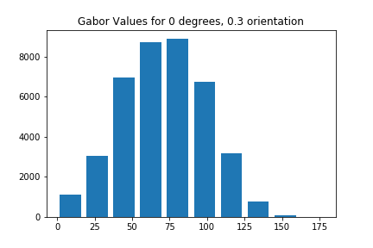
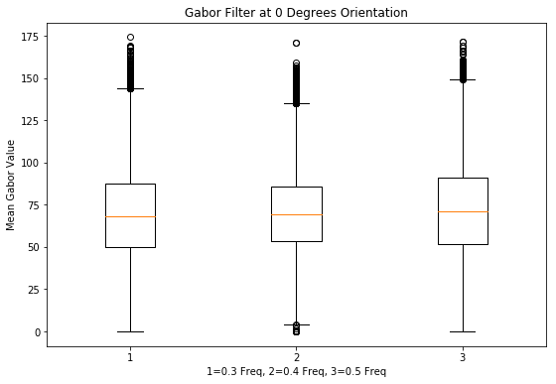
Gabor Values for 0 Degrees Orientation
Notes:
We don’t want to overwhelm viewer with a bunch of similar-looking plots, so a representative sample is shown here.
On the left is a histogram for one set of sample outputs of Gabor values (0 degrees, 0.3 orientation). On the right are side by side boxplots showing 0 degrees for all three orientations.
Boxplot #1 is the 0 degree Gabor filter at an orientation value of 0.3
Boxplot #2 is the 0 degree Gabor filter at an orientation value of 0.4
Boxplot #3 is the 0 degree Gabor filter at an orientation value of 0.5

Slide 15
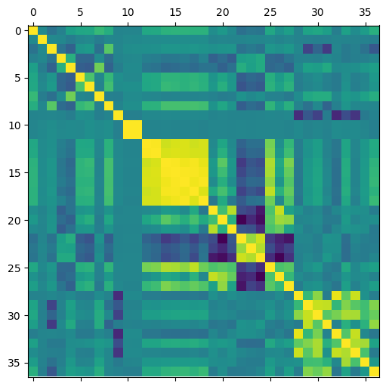
Correlation Matrix for Numeric Data
Semantic ratings of a nodule show no linear relationship.(0-8)
For Content-Based features:
Size features show positive correlation(9-19)
Some shape 2D features are positively correlated eg.Eccentricity, Solidity, Extent (20-27)
Most intensity features are weak positively correlated (28-37)
Notes:
0-8 is 9 attributes of Semantic ratings of a nodule by a radiologist
Others are Content-Based features:
9-19 are Size And 20-27 are Shape 2D features
28-37 are intensity features
1 subtlety
2 internalStructure
3 calcification
4 sphericity
5 margin
6 lobulation
7 spiculation
8 texture
9 malignancy
10 imageZposition
11 PixelSpacing
12 PixelArea
13 Area
14 ConvexArea
15 Perimeter
16 ConvexPerimeter
17 EquivDiameter
18 MajorAxisLength
19 MinorAxisLength
20 Elongation
21 Compactness
22 Eccentricity
23 Solidity
24 Extent
25 Circularity
26 RadialDistanceSD
27 SecondMoment
28 Roughness
29 MinIntensity
30 MaxIntensity
31 MeanIntensity
32 SDIntensity
33 MinIntensityBG
34 MaxIntensityBG
35 MeanIntensityBG
36 SDIntensityBG
37 IntensityDifference

Slide 16
Literature Review
Lung nodule malignancy classification using only radiologist-quantified image features as inputs to statistical learning algorithms: probing the Lung Image Database Consortium dataset with two statistical learning methods, Matthew C. Hancock,Jerry F. Magnan, 2016
Summary:
Methods: investigates the predictive capability of statistical learning methods for classifying nodule malignancy
Goal: determine the potential usefulness of quantified diagnostic image features as inputs to a CAD system
Related work: Three approaches to CAD

Slide 17

Literature Review
Statistical learning techniques: logistic regression and random forests
Data set:
N= 2817 samples
which belong to 530 of the available total of 1018 scans
omit 399 cases using the inconsistent rating systems and cases that are labeled indeterminate malignancy
Classification accuracy:
Ideal classifier
theoretical maximum of 90.17%
Image features are inputs and malignancy category are outputs
Four most relevant features for classification: spiculation, lobulation, subtlety, and calcification

